Slide 1
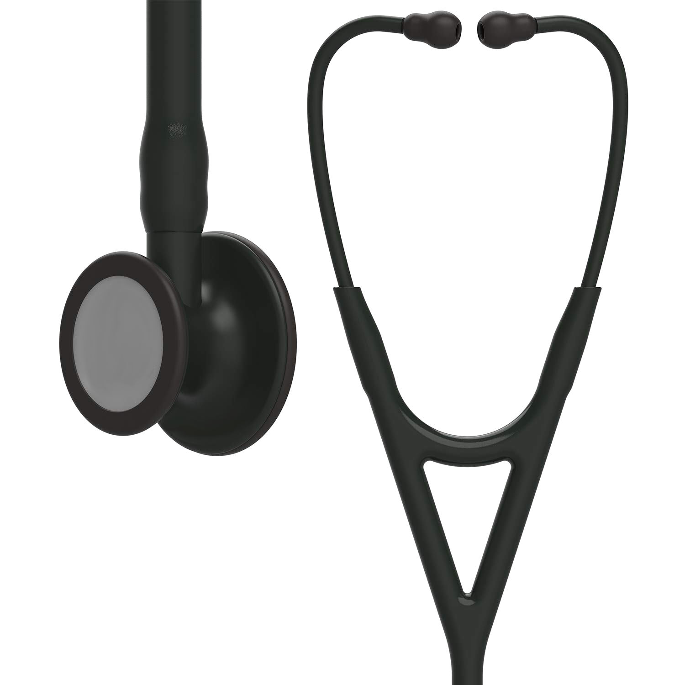

A New Normal for the Clinician’s Third Hand:
1
Virtual Grand Rounds #1
Stethoscope Hygiene and Infection Prevention
Speaker: W. Frank Peacock, MD
February 2, 2023

Slide 2


2
AseptiScope provides Infection Protection for Clinician & Patient with novel aseptic solutions.
If you are a clinician, we are dedicated to making infection control fast and simple. If you are a patient, we are here to protect you. We are driven to bring innovative and validated solutions that lower the risk of contamination and infection in healthcare systems.

Slide 3

Stethoscope, the Clinician’s Third Hand
3
Pathogen
Volume & Diversity
Patient Contact
Transmission Vector
The stethoscope diaphragm carries the same volume and diversity of pathogens as the hand.
The stethoscope diaphragm often comes into direct physical contact with the patient, just as the hands do.
The stethoscope diaphragm is therefore a potent vector of pathogens, and for this reason can be considered the clinician’s third hand.
Peacock WF. A New Normal for The Clinician's Third Hand: Stethoscope Hygiene and Infection Prevention. Am J Infect Control. 2022 Nov 6:S0196-6553(22)00757-X. PMID: 36351475.

Slide 4

Presenter William F. Peacock, M.D.
4
Virtual Grand Rounds #1
AJIC - A New Normal for the Clinician’s Third Hand:
Stethoscope Hygiene and Infection Prevention
Chief Medical Officer & Co-Founder of AseptiScope
Professor, Research Director and Vice Chair for Research at Baylor College of Medicine
Notes:
Dr. Peacock serves as the Chief Medical Officer of AseptiScope. He is a Professor of Emergency Medicine and Vice Chair for Research in the department of Emergency Medicine at Baylor College of Medicine, in Houston, Texas. With more than 600 publications, he is a two-time winner of the Best Research Paper of the Year Award from the American College of Emergency Physicians and is the recipient of the 2019 Ray Bahr Award for Excellence from the American College of Cardiology.
He is the primary author of today’s topic, the newly published AJIC Article, A New Normal for the Clinician’s Third Hand: Stethoscope Hygiene and Infection Prevention

Slide 5
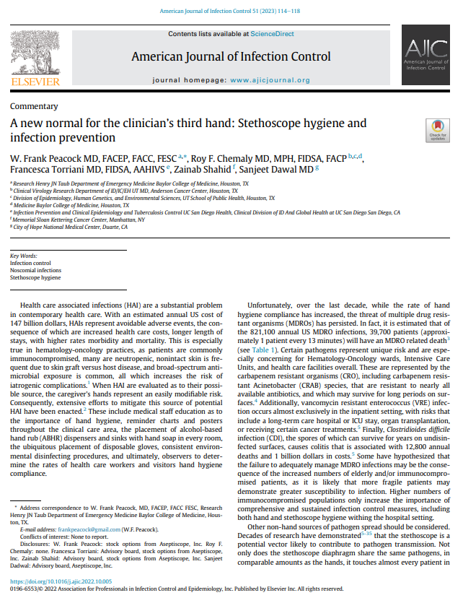




Roy F. Chemaly MD, MPH, FIDSA, FACP MD Anderson Department of Infectious Diseases, Infection Control, and Employee Health, Division of Internal Medicine
5
Co-Authors
Francesca Torriani MD, FIDSA, AAHIVS
UC San Diego Health
Infectious Disease Specialist Medical Director, Infection Prevention and Clinical Epidemiology Professor of Medicine
Zainab Shahid, MD
Memorial Sloan Kettering
Infectious Disease Specialist, Infection Management in Patients with Blood Cancer and in Hematopoietic Transplant and Cellular Therapy Recipients, and Immunocompromised People
Sanjeet Dadwal, MD
City of Hope
Chief, Division of Infectious Diseases;
Physician
Notes:
Authors of AJIC Paper
A New Normal for the Clinician’s Third Hand:
Stethoscope Hygiene and Infection Prevention

Slide 6


6
Healthcare Associated Infections (HAIs)
HAIs are avoidable adverse events, with an estimated annual US cost of $147 billion.
Consequences are:
increased health care costs
longer length of stays
higher rates morbidity and mortality.
Especially true in hematology-oncology practices, as patients are commonly:
Immunocompromised
Neutropenic
Have non-intact skin is frequent due to skin graft versus host disease
Broad-spectrum antimicrobial exposure is common
….all of which increase the risk of iatrogenic complications
The mortality rate of HAIs in the US (100,000/year) is comparable to a large commercial airliner falling out of the sky with no survivors each and every day.
Peacock WF. A New Normal for The Clinician's Third Hand: Stethoscope Hygiene and Infection Prevention. Am J Infect Control. 2022 Nov 6:S0196-6553(22)00757-X. PMID: 36351475.
Notes:
Peacock WF. A New Normal for The Clinician's Third Hand: Stethoscope Hygiene and Infection Prevention. Am J Infect Control. 2022 Nov 6:S0196-6553(22)00757-X. PMID: 36351475.

Slide 7

Certain MDRO pathogens have unique risks and are especially concerning for Hem-Onc wards
7

Slide 8
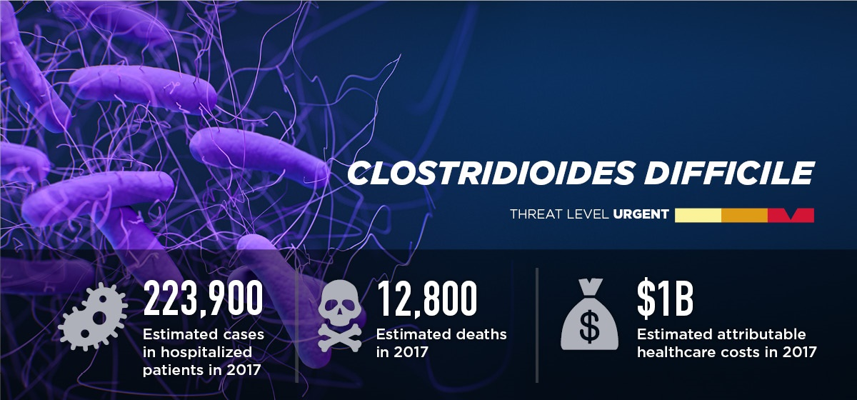
8
Clostridioides difficile Infection (CDI)
Clostridioides difficile infection (CDI) spores survive for years on undisinfected surfaces and are not killed by alcohol.
“2019 Antibiotic Resistance Threats Report.” Centers for Disease Control and Prevention, Centers for Disease Control and Prevention, 23 Nov. 2021

Slide 9
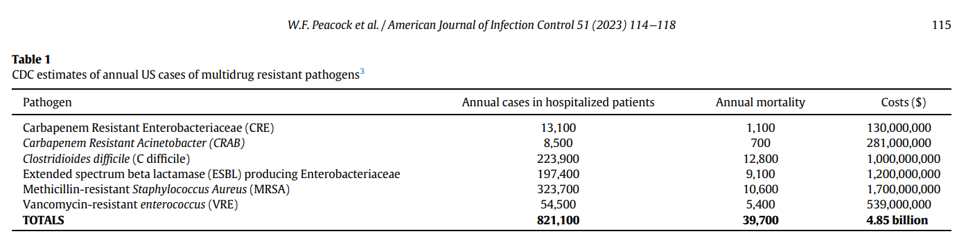
9
Table 1. CDC Estimates of Annual US Cases of Multidrug Resistant Pathogens
Peacock WF. A New Normal for The Clinician's Third Hand: Stethoscope Hygiene and Infection Prevention. Am J Infect Control. 2022 Nov 6:S0196-6553(22)00757-X. PMID: 36351475.
Notes:
Peacock WF. A New Normal for The Clinician's Third Hand: Stethoscope Hygiene and Infection Prevention. Am J Infect Control. 2022 Nov 6:S0196-6553(22)00757-X. PMID: 36351475.

Slide 10

Key Concept: HAIs & Stethsocope Hygiene
10
Healthcare Associated Infections (HAIs) lead to increased health care costs, longer length of stay, and higher rates of morbidity and mortality.
Insitutions that serve immunocomprimsed patients particulary require an elevation in stethoscope hygiene standards to protect these vulnerable populations.
Healthcare Associated Infections (HAIs)
Immunocompromised Patients

Slide 11


11
Two Dirty Secrets
Stethoscopes are nasty and covered in bugs from the last patient
Nobody cleans them

Slide 12
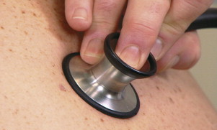
12
Clinical Data
Contamination of Gowns, Gloves, and Stethoscopes With Vancomycin‐Resistant Enterococci
From 1/97 to 12/98, 49 patients colonized or infected with VRE.
After routine examination
Glove fingertips, gown and stethoscope diaphragm were pressed onto Columbia colistin-nalidixic acid agar plates with 5% sheep blood plus vancomycin 6 pg/mL.
Zachary KC. Contamination of gowns, gloves, and stethoscopes with vancomycin-resistant enterococci. Infect Ctrl Hosp Epid. 2001 Sep;22(9):560-4.

Slide 13
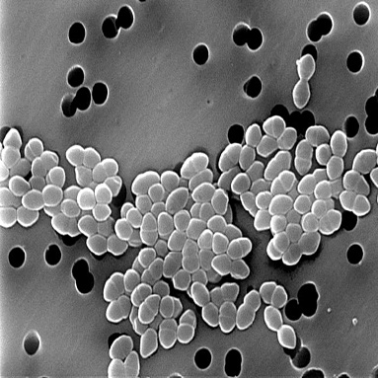




VRE: Isolated in 33 (67%) of 49 Cases
31%
37%
Stethoscopes
Gowns
63%
Gloves
13
1 in 5 of total
2% still positive after wiping with 70% alcohol swab.
Zachary KC. Contamination of gowns, gloves, and stethoscopes with vancomycin-resistant enterococci. Infect Ctrl Hosp Epid. 2001 Sep;22(9):560-4.

Slide 14
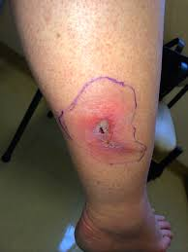
14
Clinical Data
Routes of Transmission
Known MRSA infected patients
Gloved hands, stethoscope diaphragm, and clothing touched patient, then cultured
52% Gloved hand
48% Clothing
40% stethoscope diaphragm
Thakur M. Inf Cntrl & Hosp Epid (2020), 1–6
14

Slide 15
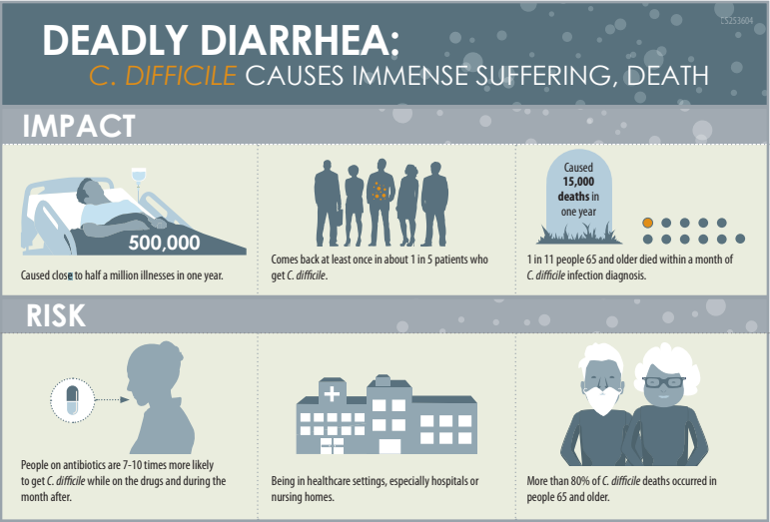

15
Clostridioides difficile

Slide 16

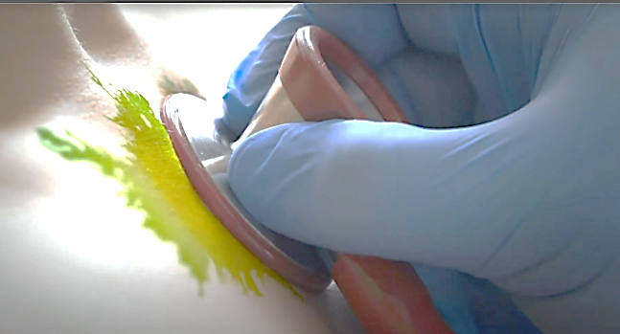
How often is C. Diff on the stethoscope?
16
Clinical Data
Stethoscopes from 54 doctors in 7 medical wards,
screened on 2 days (n=61) at the Leicester Royal Infirmary
Bell and diaphragm of each stethoscope was swabbed for 10s.
Swab was spread onto a C. diff selective agar plate [CCEY
enriched with lysosyme (E&O Laboratories Ltd,
Bonnybridge, UK)] and incubated for 5 days in an
anaerobic cabinet at 37 C before inspection.
C. diff was isolated from 3 (4.9%) of the 61 stethoscopes,
all from the doctors’ stethoscopes.
ANSWER = 5%
Alleyne SA, Hussain AM, Clokie M, Jenkins DR. Stethoscopes: potential vectors of Clostridium difficile. J Hosp Infect. 2009 Oct;73(2):187-9. doi: 10.1016/j.jhin.2009.05.014. Epub 2009 Aug 28. PMID: 19716204.
Notes:
Alleyne SA, Hussain AM, Clokie M, Jenkins DR. Stethoscopes: potential vectors of Clostridium difficile. J Hosp Infect. 2009 Oct;73(2):187-9. doi: 10.1016/j.jhin.2009.05.014. Epub 2009 Aug 28. PMID: 19716204.

Slide 17

Contaminated Stethoscopes Revisited
17
Clinical Data
Four Hospitals
200 Stethoscopes
Cultures obtained from each stethoscope
Results Recorded
Smith, ML. Contaminated Stethoscopes Revisited. Arch Int Med. 156 (1996) 82-84.
Notes:
Smith, ML. Contaminated Stethoscopes Revisited. Arch Int Med. 156 (1996) 82-84.

Slide 18
Contaminated Stethoscopes Revisited
18
Clinical Data
Staph Species | N=219 (83%)
Epidermidis | 95 (36)
Haemolyticus | 37 (14)
Aureus | 24 (9)
Hominis | 17 (6)
Cohnii | 16 (6)
Warneri | 13 (5)
Capitis | 8 (3)
Simulans | 3 (1)
Saprophyticus | 3 (1)
Lentus | 2 (1)
Sciuri | 1 (0.4)
83%
Species | N (%)
Micrococcus species | 29 (11)
Bacillus species | 9 (3)
Listeria monocytogenes | 2 (1)
Acinetobacter species | 2 (1)
Candida albicans | 1 (0.4)
Streptococcus faecalis | 1 (0.04)
Smith, ML. Contaminated Stethoscopes Revisited. Arch Int Med. 156 (1996) 82-84.
Notes:
Smith, ML. Contaminated Stethoscopes Revisited. Arch Int Med. 156 (1996) 82-84.

Slide 19

Key Concept: Is Handwashing Enough?
19
What about
The Clinician’s Third Hand!
The hands have been identified as a major risk for HAIs, and many hand hygiene measures are put in place.
Multiple pathogens, including C. diff, continue to pose major threats despite all efforts in hand hygiene.
Hand hygiene is elevated
yet HAIs persist

Slide 20
20
In direct observational studies, stethoscope cleaning between patients occurs less than 4% of the time.

Slide 21
21
Clinical Data
Community hospital stethoscope
cleaning practices and contamination rates
N=104 cultured stethoscopes from Dr’s, RN’s, and RT’s:
No statistical difference between self-reported cleaning frequency or
methods, and the presence of bacteria
86.5%
91.4%
Claimed CDC compliant disinfection frequency
Bacterial growth
Alali SA, Shrestha E, Kansakar AR, Parekh A, Dadkhah S, Peacock WF. Am J Infect Control. 2020 Nov;48(11):1365-1369. doi: 10.1016/j.ajic.2020.04.019. PMID: 32360747.
Notes:
Alali SA, Shrestha E, Kansakar AR, Parekh A, Dadkhah S, Peacock WF. Am J Infect Control. 2020 Nov;48(11):1365-1369. doi: 10.1016/j.ajic.2020.04.019. PMID: 32360747.

Slide 22
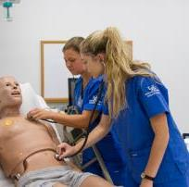
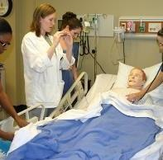
22
Clinical Data
Effectiveness of Precautions?
The Two-Mannequin Study
Bugs
Bugs
Bugs
Bugs
Bugs
Bugs
Bugs
30 Volunteers
3 Sim Mannequin Exams
Surrogate Markers
Cauliflower mosaic virus DNA
Bacteriophage MS2
Nontoxic C. diff spore
Fluorescent tracer
Alhmidi H. Infect Cntrl & Hosp Epid (2020), 1–6
Notes:
Authors of AJIC Paper

Slide 23
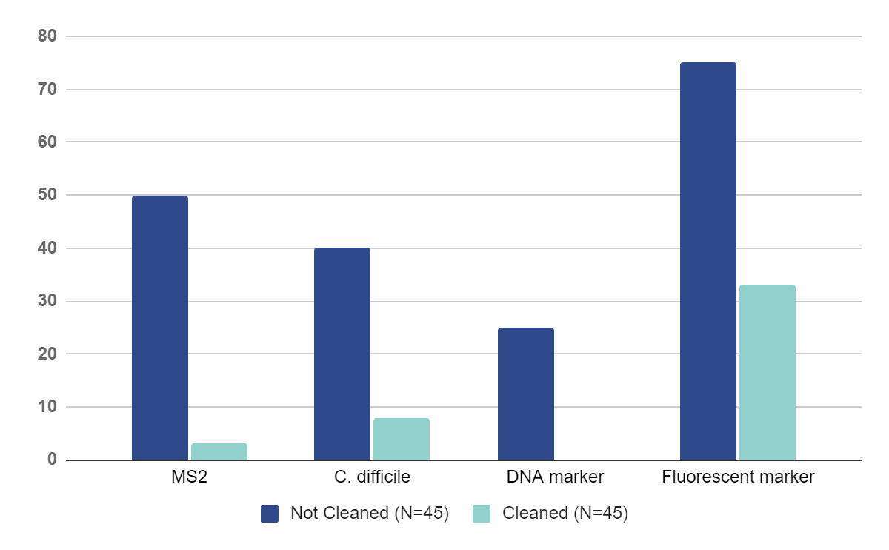
23
Transfer of pathogen surrogate markers from a contaminated to clean mannequin by stethoscopes
Clinical Data
(a)
Effectiveness of Precautions?
The Two-Mannequin Study
Percent positive
Alhmidi H. Infect Cntrl & Hosp Epid (2020), 1–6

Slide 24
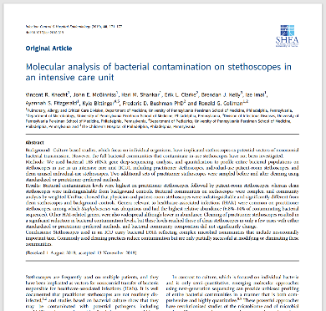
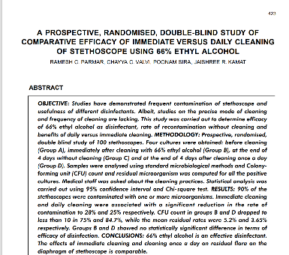
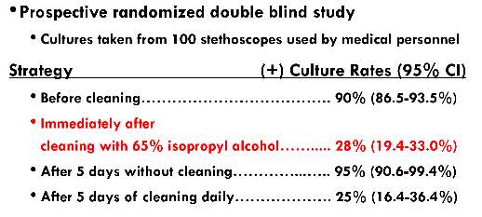
24
If cleaning occurs, does it even work?
“Commonly used cleaning practices reduce contamination but are only partially successful at modifying or eliminating these communities”
Knecht, Infection Control & Hospital Epidemiology (2018), 0,1-7 doi:10.1017/ice.2018.319
Parmar, RC, et al. Indian J Med Sci 2004: 58:423-30.
Notes:
Knecht, Infection Control & Hospital Epidemiology (2018), 0,1-7 doi:10.1017/ice.2018.319
Parmar, RC, et al. Indian J Med Sci 2004: 58:423-30.

Slide 25

Key Concept: Stethoscope Cleaning Infrequency & Ineffectiveness
25
Self-reported stethoscope hygiene rates are never accurate and higher than the actual, observed rates.
Commonly used cleaning practices reduce contamination but are only partially successful at modifying or eliminating these communities
Stethoscope hygiene infrequency
Cleaning is only partially effective

Slide 26
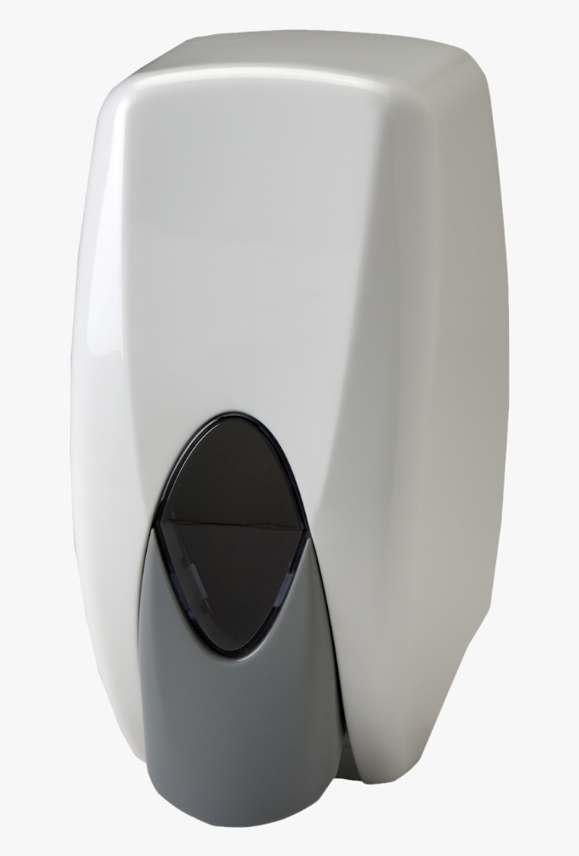
Increasing tolerance of hospital Enterococcus faecium to handwash alcohols
26
Key to control hospital infections
Alcohol-based disinfectants
Particularly hand rubs
Restrict transmission of pathogens
Multidrug-resistant Staphylococcus aureus
Enterococcus faecium.
Despite this success, health care infections caused by E. faecium are increasing.
Hand Sanitizer
SJ Pidot. Increasing tolerance of hospital Enterococcus faecium to handwash alcohols. Sci. Transl. Med. 10, eaar6115 (2018)
Notes:
SJ Pidot. Increasing tolerance of hospital Enterococcus faecium to handwash alcohols. Sci. Transl. Med. 10, eaar6115 (2018)

Slide 27
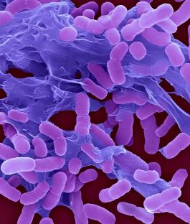
27
Clinical Data
Low concentrations of commercial alcohol hand rubs
FACILITATE GROWTH of MDR strains of Acinetobacter baumannii
Growth of MDRAB in minimal media (MM) following supplementation with 0.01–10% ethanol.
Edwards J. J Med Microbiol. 2007 Dec;56(Pt 12):1595-1599. PMID: 18033825.
Notes:
Edwards J. J Med Microbiol. 2007 Dec;56(Pt 12):1595-1599. PMID: 18033825.

Slide 28
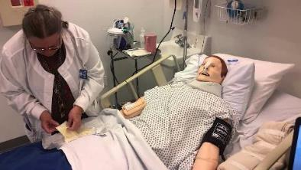



28
Aseptic Disposable Stethoscope Barrier: Acoustically Invisible and Superior to Disposable Stethoscopes
Clinical Data
Simulation Mannequin
High Fidelity Recording Stethoscope
Disposable Stethoscope
4 Auscultation Sounds
Kalra, S. 2021 Jan;96(1):263-264. doi: 10.1016/j.mayocp.2020.10.029
Notes:
Kalra, S. 2021 Jan;96(1):263-264. doi: 10.1016/j.mayocp.2020.10.029

Slide 29
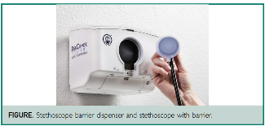
29
Disposable Stethoscope Misdiagnosis = 11% vs DiskCover Stethoscope Misdiagnosis = 0%
Clinical Data
In 800 high fidelity stethoscope auscultations:
No diagnostic accuracy difference with (n=400) or without (n=400) a barrier (p=1.0).
No differences in digital acoustic output tracing amplitude (p=1.0).
In 220 observations, auscultation misdiagnosis:
10.9% (n=12/110) with the disposable stethoscope
0% (0/110) with the Disk Cover barrier protected recording stethoscope
Dr’s preferences:
95% Preferred the DiskCover Protected Stethoscope vs Disposable Stethoscope
Percent Missed Diagnosis
Kalra S. Ann of EM 2020. S4
Notes:
Kalra S. Ann of EM 2020. S4

Slide 30
30
Evaluation of Dedicated Stethoscopes as a Potential Source of Nosocomial Pathogens
Clinical Data
78 dedicated stethoscope earpieces cultured
17% (13/78) were contaminated with potentially pathogenic bacteria:
2 with S aureus (1 MRSA)
1 with E faecalis
7 with Acinetobacter species
2 with Pseudomonas species
1 with Escherichia coli
1 with Moraxella.
None were contaminated with the same pathogen for which the patient was prescribed contact precautions.
Guinto CH. Evaluation of dedicated stethoscopes as a potential source of nosocomial pathogens. Am J Infect Control. 2002 Dec;30(8):499-502. PMID: 12461514.
Alleyne SA, Hussain AM, Clokie M, Jenkins DR. Stethoscopes: potential vectors of Clostridium difficile. J Hosp Infect. 2009 Oct;73(2):187-9. doi: 10.1016/j.jhin.2009.05.014. Epub 2009 Aug 28. PMID: 19716204.
Notes:
Guinto CH. Evaluation of dedicated stethoscopes as a potential source of nosocomial pathogens. Am J Infect Control. 2002 Dec;30(8):499-502. PMID: 12461514.

Slide 31
31
Clinical Data
Disposable Stethoscopes:
Do you really want to share (or is it just too gross?)
24 ICU bedside stethoscopes
Before cleaning: 5 earpieces had pathogens
After cleaning: 1 (4.2%) earpieces: MRSA
22 Personal stethoscopes
Before cleaning: 5 earpieces had pathogens
After cleaning: 2 (9.1%) earpieces: Psuedomonas, A. Buamanii
Whittington AM. Bacterial contamination of stethoscopes on the intensive care unit. Anaesthesia, 2009, 64: 620–624
Notes:
Whittington AM. Bacterial contamination of stethoscopes on the intensive care unit. Anaesthesia, 2009, 64: 620–624

Slide 32

Key Concept: Ineffectiveness of Current Standards
32
Alcohol is not effective against all pathogens such as C. diff, can contribute to alcohol resistance, and used can potentially increase C. diff sporulation.
Disposable stethoscopes have poor sound quality, which can potentially cause clinical harm. They also have the potential of transmission of pathogens from patients to their caregivers.
Alcohol Disinfection
Disposable Stethoscopes

Slide 33

Stethoscope:
The Clinician’s Third Hand
33
The stethoscope, commonly termed the clinician’s third hand for both its frequency of engagement with the patient, as well as its role as a transmission vector, is likely a much-neglected fomite in infection prevention.

Slide 34
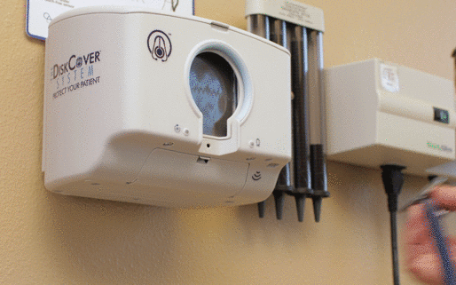
34
Touch Free Aseptic Barrier Dispenser

Slide 35

35
Clinical Data
Are Aseptic Barriers Effective?
Bacteria obtained from Saliva, Stool, Sputum, Urine
Barriers were tested after 24 hours of exposure to:
3 different strains of 7 human pathogens that included:
Extended-spectrum beta lactamase E. coli
Methicillin resistant Staphylococcus aureus (MRSA)
Vancomycin resistant Enterococcus faecium (VRE)
Bacteroides sp.
Vasudevan R. Aseptic Barriers Allow a Clean Contact for Contaminated Stethoscope Diaphragms Mayo Clin Proc. 2019

Slide 36
36
Are Aseptic Barriers Effective?
Clinical Data
Methodology
Vasudevan R. Aseptic Barriers Allow a Clean Contact for Contaminated Stethoscope Diaphragms Mayo Clin Proc. 2019

Slide 37
37
Are Aseptic Barriers Effective?
Clinical Data
Results
With Barrier
Vasudevan R. Aseptic Barriers Allow a Clean Contact for Contaminated Stethoscope Diaphragms Mayo Clin Proc. 2019

Slide 38
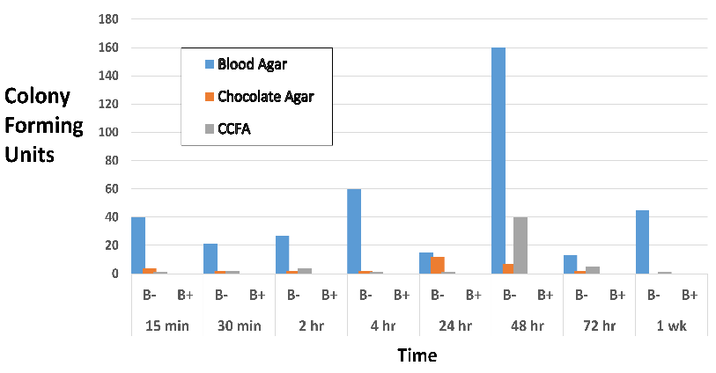
38
Clinical Data
C. difficile vs. DiskCover Barrier
(Cycloserine Cefoxitin Fructose Agar)
Peacock, W. Frank, et al. “Aseptic Stethoscope Barriers Prevent C Difficile Transmission in Vitro.” Mayo Clinic Proceedings: Innovations, Quality & Outcomes, vol. 5, no. 1, 2021, pp. 103–108.,
Notes:
Peacock, W. Frank, et al. “Aseptic Stethoscope Barriers Prevent C Difficile Transmission in Vitro.” Mayo Clinic Proceedings: Innovations, Quality & Outcomes, vol. 5, no. 1, 2021, pp. 103–108.,

Slide 39

DiskCover System “Beta Sites” Partnered
with us on 2 objectives
39
Assess Product locally as we optimize it in San Diego Manufacturing
Participate in our Multi-Center End User Assessment (EUA) Study
6 Centers Assessing
UCSD Urgent Care
7 Systems LJ
10 Systems RB
Beta Sites
BronxDocs
16 Systems
Beta Site
Kipper Clinic
2 Systems
Beta Site
Dayton MDs
2 Systems
Beta Site
Select Specialty
13 Systems
Beta Site
Wahiawa General
4 Systems
Beta Site

Slide 40

Establish ease of compliance and workflow compatibility (End User Acceptance Study)
40
Series of 5-Point Likert Scale Survey Questions
Data Entered, Logged, and Downloaded via I-Pad Survey Tool
Locations included:
ICU
Telemetry
Emergency
Urgent Care
Primary Care Clinic
Oncology Clinic

Slide 41


DiskCover System: Perceived Ease of Use: Ranked Easy or Very Easy 93% of the Time
41

Slide 42

85% believe the DiskCover System Is An Improvement vs. Disposable Stethoscopes
42

Slide 43
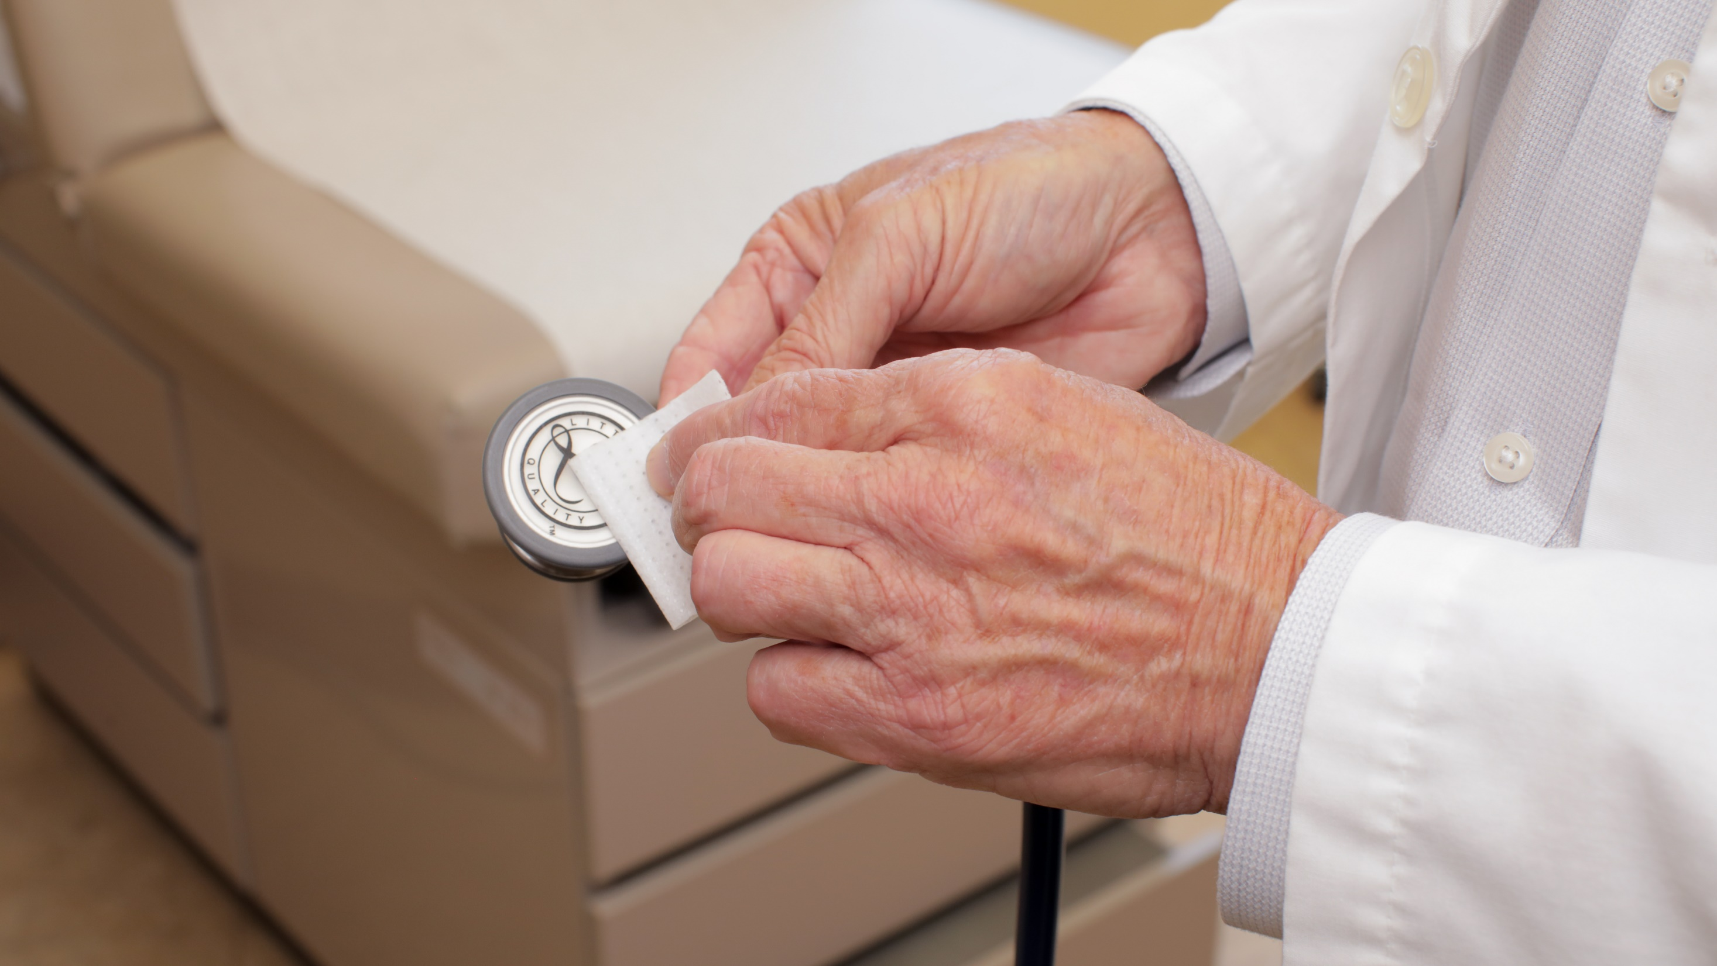
95% of Users Believe The DiskCover System either Improves or has Neutral Impact on Workflow
43

Slide 44

95% of Users Believe The DiskCover System Will Improve Stethoscope Hygiene
44

Slide 45

45
95% of Users Believe The DiskCover System Will Improve Patient Safety
45

Slide 46
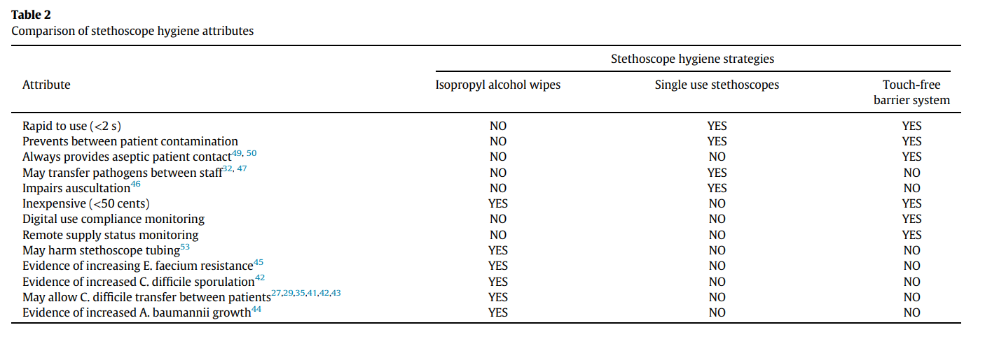
46
Only Touch-Free, Aseptic Barriers Capture All Desired Stethoscope Hygiene Attributes
Peacock WF. A New Normal for The Clinician's Third Hand: Stethoscope Hygiene and Infection Prevention. Am J Infect Control. 2022 Nov 6:S0196-6553(22)00757-X. PMID: 36351475.

Slide 47





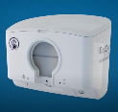
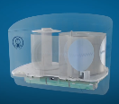
47
Users Agree, The DiskCover System
is Easy to Use
The DiskCover System brings touch-free dispensing of aseptic barriers to clinical care utilizing three uniquely integrated components
EASY
VERY
EASY
1
2
3
The Aseptic Disk Cover
Robust, single-use barrier
Acoustically Invisible for sound
Biocompatible for patients
Peel tab for easy removal
The Clean-Cassette
Assembled in clean room conditions
Houses 420 single-use disk covers
Maintains aseptic condition of disk cover
Easily inserted into Dispenser
The Touch-Free Dispenser
Ensures touch-free aseptic application
Includes state-of-the-art sensor technology
Intuitive, requires no formal training
Wall mount easy to install

Slide 48

Thank you and see you next time!
48
CREDITS:
Presentation template adapted from slidesgo.com
Icons by Flaticon
Infographics & images by Freepik
Illustrations by Stories
Questions?
William F. Peacock, M.D.
frankpeacock@gmail.com

